Slide 1
Counting Use Case Points
Peter Bink
December 7th, 2006

Slide 2
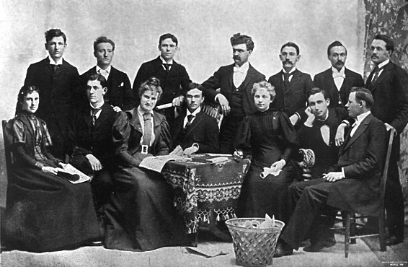
The history of and rationale behind use case points
Initiated by Capgemini US and UK in 2000
to determine functional size in an early stage.
NL involved since 2001
Not a global standard way of counting functional
size.
Requirements: Quantifying the functional size
  Correlation with FPs and SLOCs
  Connected to RUP
  Easy to count
UCP is now used for:
  Most of our top down estimates
  All project closure evaluations
  For .NET, JAVA and BI projects

Slide 3
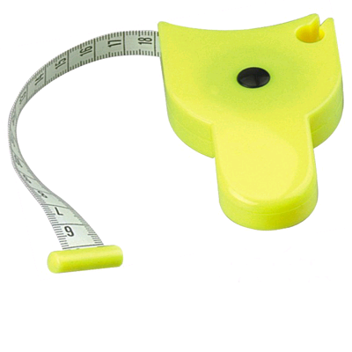

Where are Use Case Points based on?
Flows
  Main flow
  Alternative flows
  Errorflows
Boundary classes
  Screens
  Interface messages
  Reports
Business rules

Slide 4

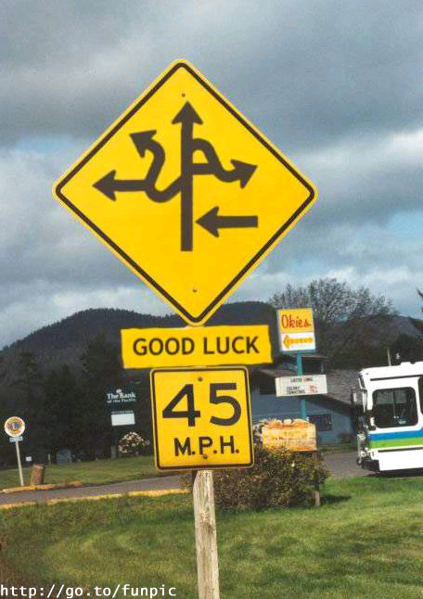
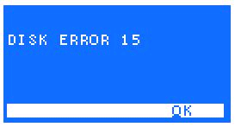
Flows
Alternative
Main
Error

Slide 5


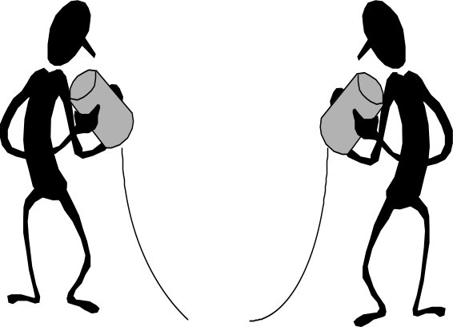
Boundary classes
High correlation
with functional size
Screens
Reports
Interfaces

Slide 6

Business rules
Business rules

Slide 7
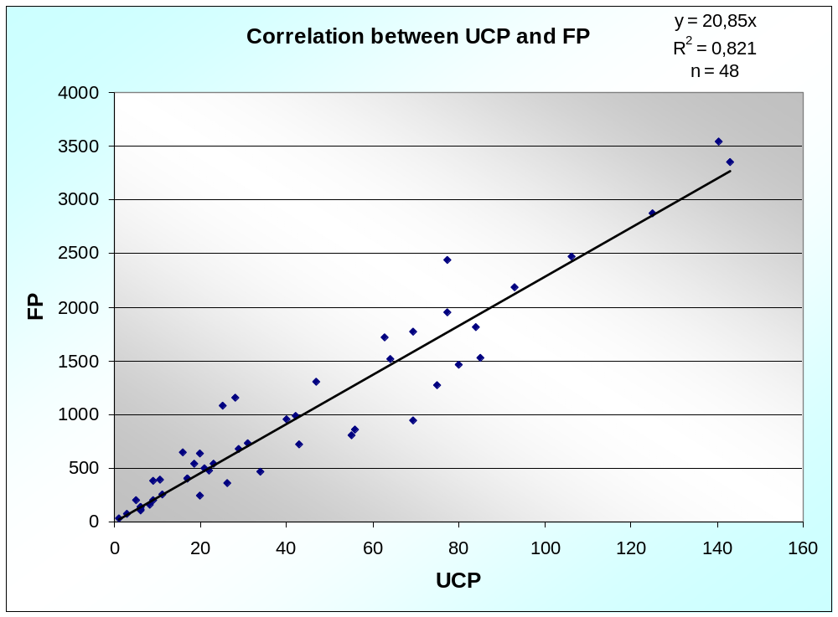
Correlation between UCP and FP
Remarks:
Dutch and English projects
For UK projects FP are backfired from SLOCs

Slide 8
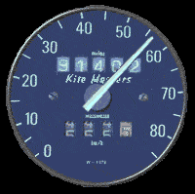


Advantages
Early sizing by experienced analyst
Intuitive approach that analysts can use if they are familiar with use cases.
The concept of use cases is persistent throughout a project
Use case sizing is easy/cheap
Easy to use with new techniques, such as SOA, Buss. Intell.
Can be used for calculations
The approach works well. There may be more accurate sizing approaches but none that we have found so far are as cheap, flexible, intuitive and easy to use up front.
Notes:
- Can be used by an experienced analyst to size a project even before the requirements have documented at detailed level.
- Can be calibrated against completed projects.
Intuitive approach that analysts can use if they are familiar with use cases. The terminology/language is not new to them and they can use the approach if they are given the guidelines - they do not need a two day training course and several years of counting experience!
The concept of use cases is persistent throughout a project from requirements to final testing so the UCP sizing approach can be reused throughout the project. The number of use cases may change as the use cases are elaborated but our experience so far is that the number of use case points does not change significantly.
Use case sizing is easy/cheap to do compared with many other sizing approaches such as Function Point counting.
The approach seems to work reasonably well. There may be more accurate sizing approaches but none that we have found so far are as cheap, flexible, intuitive and easy to use up front.

Slide 9

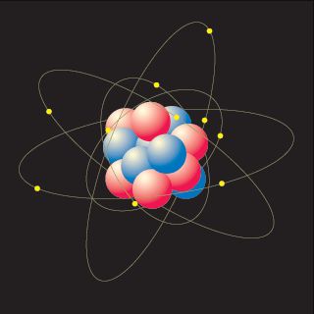
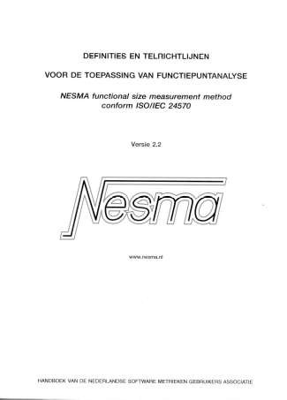
Challenges
Find the right level of aggregation
Versus
Not an accepted standardised method
Not documented in detail (like NESMA PFA)
Cannot be used easily by other companies, because there are some undocumented features

Slide 10

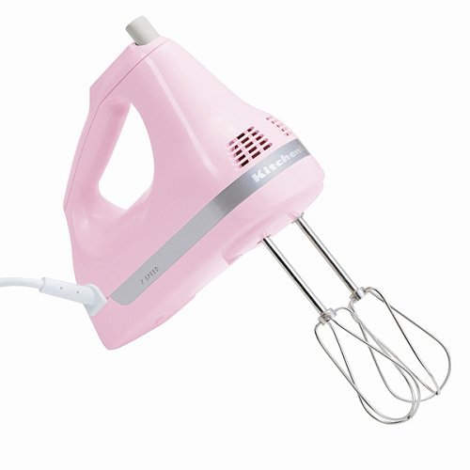
Tips & tricks
Preferably use more than one sizing method.
Don’t mix between size and productivity
  Translate complexity in productivity
  &
  Size is uniquely quantified
Calibrate regularly between people that count UCPs

Slide 11
More info
peter.bink@capgemini.com

